Slide 1
Document Object Model
Sandeep G

Slide 2
Who Am I?
Engineer / Front End developer
Worked in Software AG, MSFT, SAP
~9 years of experience
Worked in React JS, TypeScript, JS, CSS, HTML

Slide 3

Agenda
What is DOM?
What DOM Covers?
DOM Basics
HTML DOM Elements
Accessing DOM Elements

Slide 4
Introduction

Slide 5
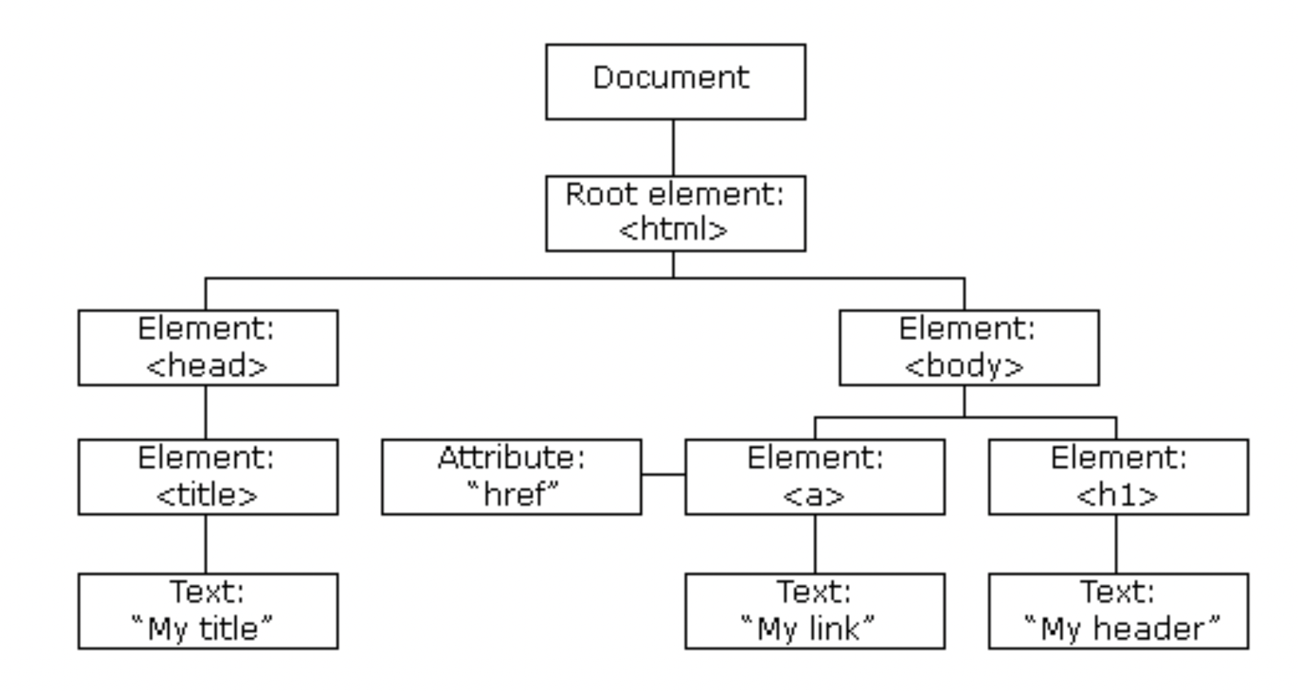
What is DOM
Programming interface that lets us add, edit, and delete components from a HTML document.
DOM views the HTML documents as a tree of nodes.
With the help of DOM, you can basically update the contents in a HTML page.

Slide 6
Accessing DOM Element
getElementById()- returns unique element
getElementsByName() - returns array of element
getElementsByTagName()- returns array of element
getElementsByClassName()- returns array of element
querySelector() - returns the first matching element, e.g. querySelector(‘#deivtag’)
querySelectorAll - returns all the matching element in an array, e.g. querySelector(‘.divtag’)

Slide 7
Happy Coding

